Slide 1
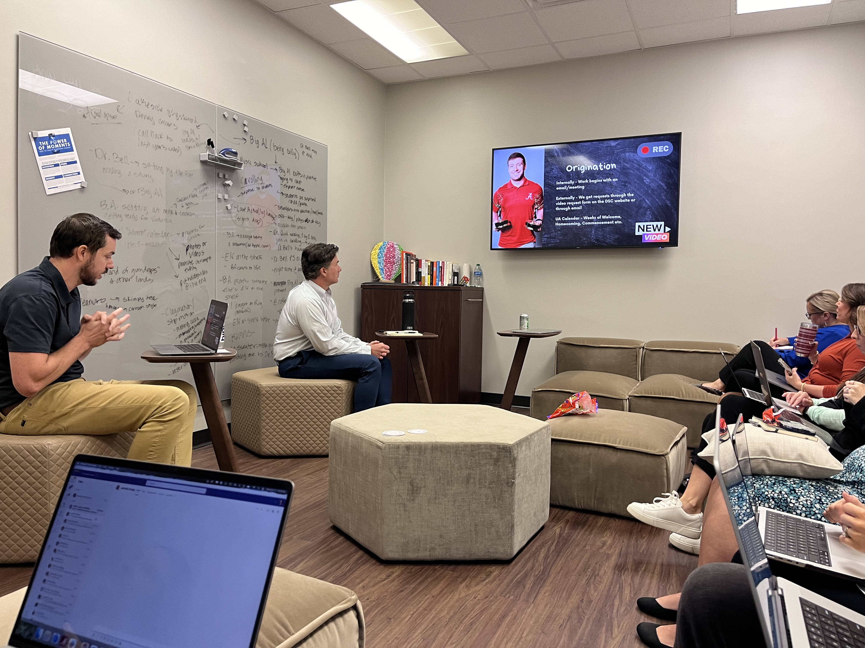
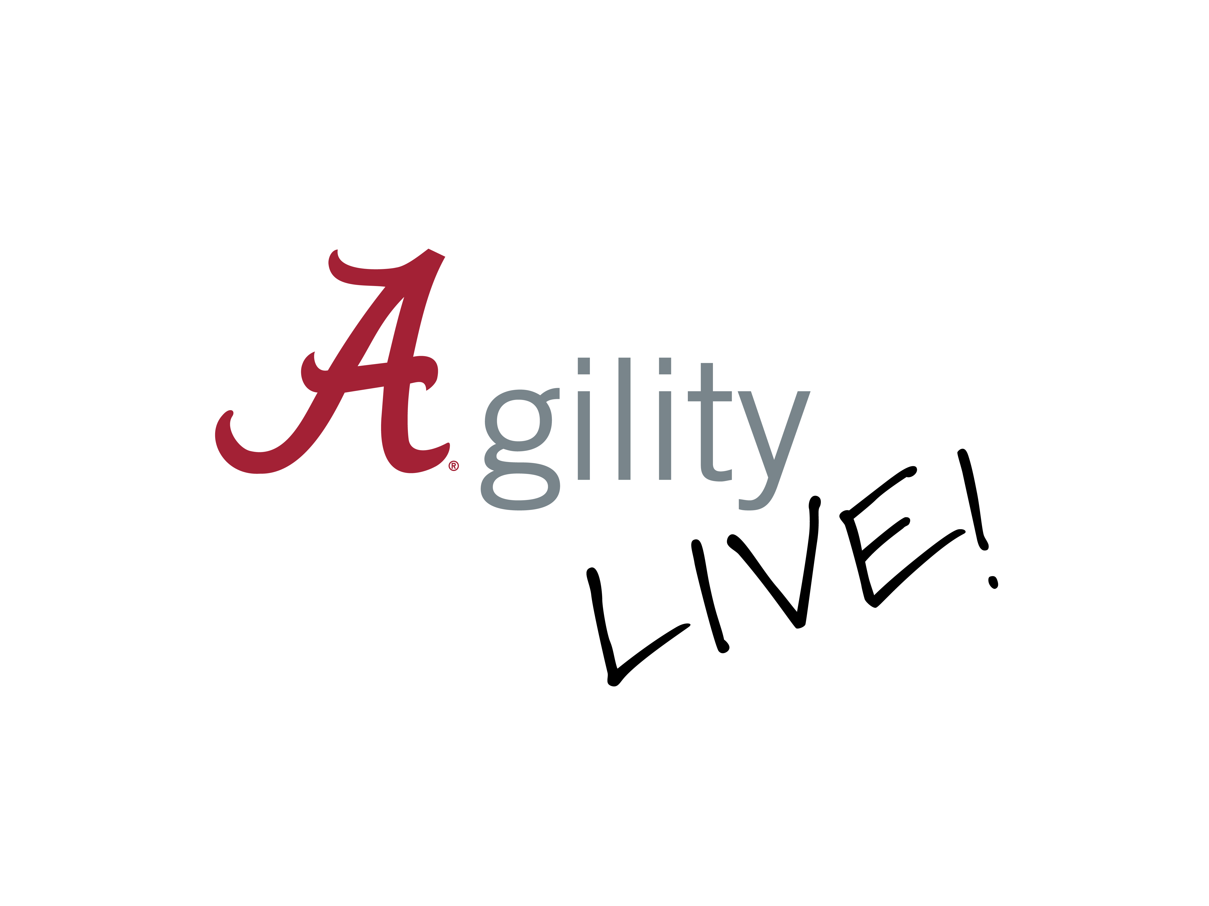
Strategic Communications
Check-in QR code
Formed an Operational Excellence Task Force (Agility Team)
Hosted department presentations to better understand one another’s work.
Working to establish consistent project/file naming convention
Defining our work to create standard procedures based on deliverables

Slide 2
Division of Student Life
Check-in QR code
Created themes per semester to increase curiosity in staff
Fall 2023 – Root Cause Analysis
Spring 2024 – Non-Value Add Activities
Coordinated two Student Life specific Agility Trainings
Added Agility Question of the Month for staff newsletters and hosted drop-in coffee hours
42%
of SL staff engaged with UA Agility Training in 2023
Student Life Agility is actively reporting on over 15 projects in departments within the division.
Also, have concluded many projects with successful outcomes such as the enhancement of departmental monthly reporting to increase efficiency.

Slide 3
Quote from Steven Hood
Check-in QR code
“In Student Life, we are committed to a model of continuous improvement. Without it, we become stagnant. Our students are constantly evolving, so we find value in always assessing and improving our efforts so we can meet their needs and empower them to thrive and succeed – here at the Capstone and beyond.”
Steven Hood – Student Life 2024

Slide 4
Division of Advancement
Check-in QR code
The Division of Advancement’s Agility Team has continued its work this past year addressing opportunities for improvement in the areas of:
Gift processing for donations made to UA and its affiliated foundations,
Communications efforts across the Division and even out
to our external constituencies, and
Enhancing user proficiency across the Division with
the utilization of the Denny CRM database.

Slide 5
OAA - OFFICE OF ACADEMIC AFFAIRS
Check-in QR code
Long-time commitment to continuous improvement.
Change Management Collective Case Study Project
6 - Committee Member Case Studies
2 - External Expert Case Studies
Lessons:
Purpose: Focus needs to be on a clearly stated goal or outcome.
Invest in the time to articulate the benefit of the stated goal.
Developing of ”team” is vital: Relationship of “the team” needs to be the first step. Making a process that works for the “team”. Achieving an “all-in” attitude.
Provide Feedback to close the loop on team effort.
Communication: Find ways that work for communicating with your team.
Understand all the stakeholders and tailor your message.
Visible demonstrations of successes.

Slide 6
OAA - OFFICE OF ACADEMIC AFFAIRS(page 2)
Check-in QR code
Change Management Collective Case Study Project
Unintended Outcomes:
Flexibility: What worked last time is not guaranteed to work this time
Never assume the change is better than before: Continual review.
Changes implemented may create new/different opportunities for improvement
OAA Agility Committee:
Ginger Bishop
Chris Coleman
Barrett Elder
Prathima Gilliam
Andrew Goodliffe
Brittany Gregg
Luoheng Han
Susan Huffman
Katheryn Meadows
Brooke Moore
Jacob Pleitz
Timothy Salazar

Slide 7
School of Social Work
Check-in QR code
The Agility team meets at least 1-2 times per semester to talk about ideas and ongoing projects.
Encourages to submit ideas and suggestions for improvements through the online portal at meetings and through emails.
Disseminates Agility concepts to Faculty and Staff in school-wide meetings and school resources page.
Workplace Continuity Project
Online request forms Project

Slide 8
Culverhouse College of Business
Check-in QR code
Using the college's strategic planning committee as the Agility team since both efforts are focused on continuous improvement.
Have four current strategic agility initiatives in the college related to:
Improving and Measuring Teaching
Collaboration & Culture of Engagement Across College
Increasing student engagement
Student Integrity

Slide 9
Capstone College of Nursing (CCN)
Check-in QR code
CCN has developed new strategic priorities and goals for 2024-2029
The Agility Team has identified two goals as our top priority:
Establish a leadership development program for faculty and staff to facilitate advancement, promotion, succession planning, and transition.
Create a quality onboarding process and a mentorship program for faculty, staff, and students.

Slide 10
College of Arts and Sciences
Check-in QR code
Centralization of the workflow for faculty job searches.
Interdepartmental financial training.
Creation of a New School of Earth & Environmental Sciences comprised of the Geography and Geology departments.
Continuous, open-ended process where ideas/suggestions can be posed & acted upon at any time.
Agility Team members:
Raymond White
Leslie Wiggins

Slide 11
Graduate School
Check-in QR code
Annual Retreat with all Graduate school employees on August 11, 2023.
Psychological Safety and Change Management workshops facilitated by the CI Department.
Process changes across both the admissions and the student-success areas:
Admissions team restructuring and Registrars’ increased use of Slate (Enrolled Student
Management).

Slide 12
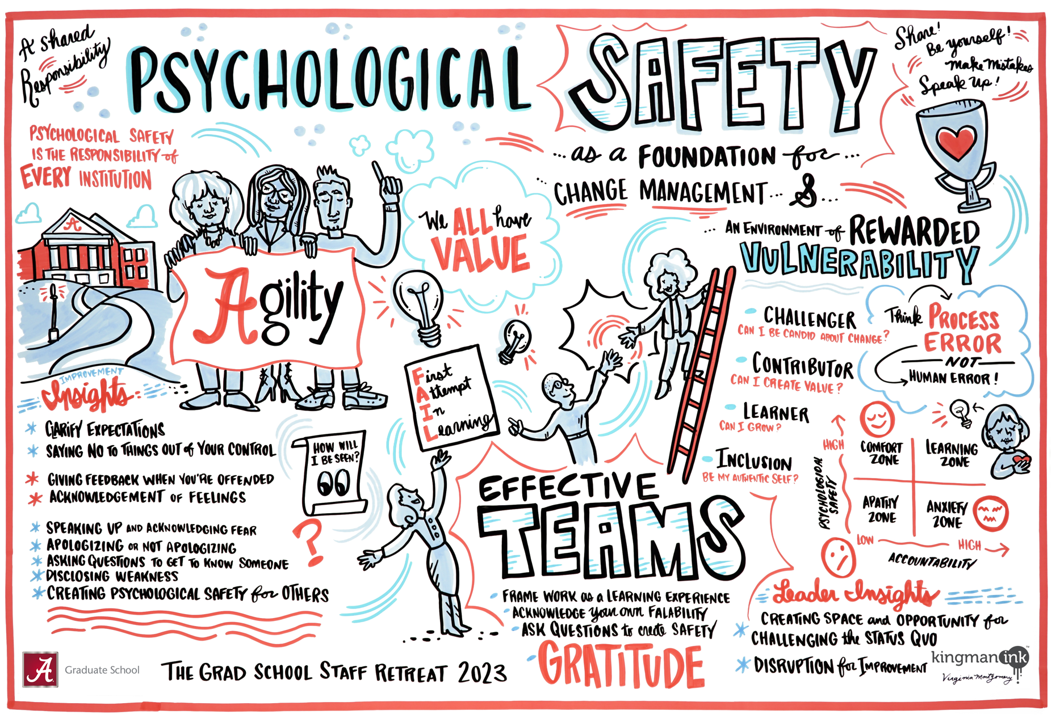
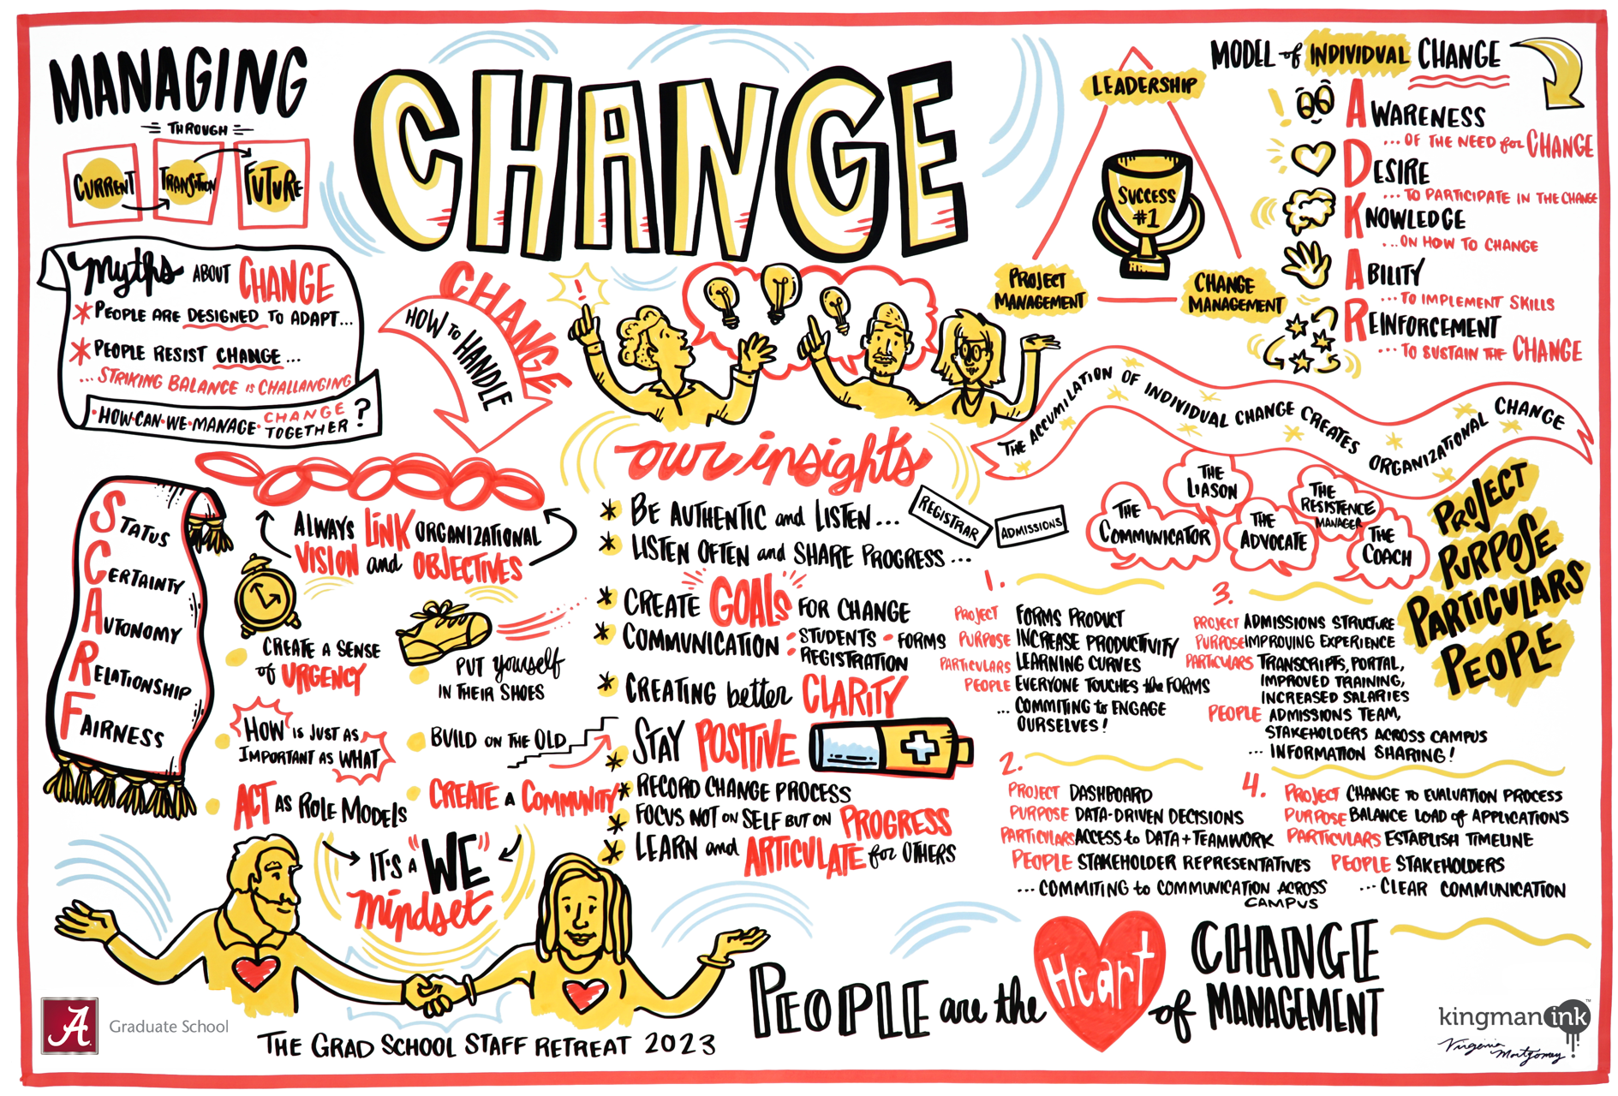
Graduate School (page 2)
Check-in QR code

Slide 13
University Libraries
Check-in QR code
Innovation in the Face of Competition: Acknowledging the growing competition in the information brokerage space, we are committed to remaining nimble and seizing new opportunities to serve our users effectively.
Strategic Planning: Agile management and continuous improvement form the foundation of our strategic planning process, guiding decisions that define our identity and future direction.
Agile Tools and Collaboration: Implementing Jira across departments has revolutionized our planning and communication workflows, enhancing cross-departmental collaboration and efficiency in project management.
User-Centric Approach: At our core, we focus on delivering resources and services that meet
the evolving needs of our users.
Student Success
Research Impact
Modern Spaces
Point-Of-Need Services
Outcomes: These agile practices ensure that University Libraries keep pace with
and out-change the competition, securing our vital role in the information ecosystem.

Slide 14
University Libraries (Page 2)
Check-in QR code
“At University Libraries, we recognize the critical need for agility in our management and strategic planning to stay ahead in the rapidly changing landscape of information brokerage. Acknowledging the challenges of competing services and the evolving demands of our academic community, we've adopted an agile methodology not just as a practice but as a principle that informs our every action.
This approach has led us to embrace innovative tools like Jira, enhancing our project management and cross-departmental collaboration, ensuring that we remain responsive and proactive in meeting the needs of our users. We affirm our commitment to continually adapting our strategies and services to outpace our competition, ensuring our enduring relevance and impact.”

Slide 15
Office of Finance
Check-in QR code
Student Account Services – Robotic Process for daily Parent Plus emails and daily Residency process.
P-card: Amazon Business Integration in Concur; Access Online (banking software) made available to campus.
Purchasing: developed and implemented a maintenance program to periodically review and update purchasing procedures.
Established the Banner Finance Users
Community of Practice.

Slide 16
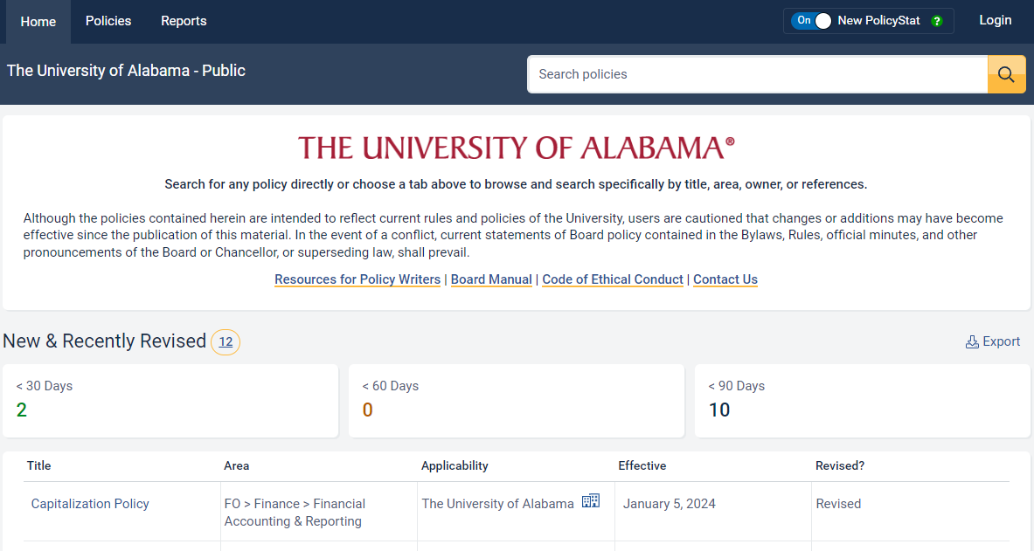
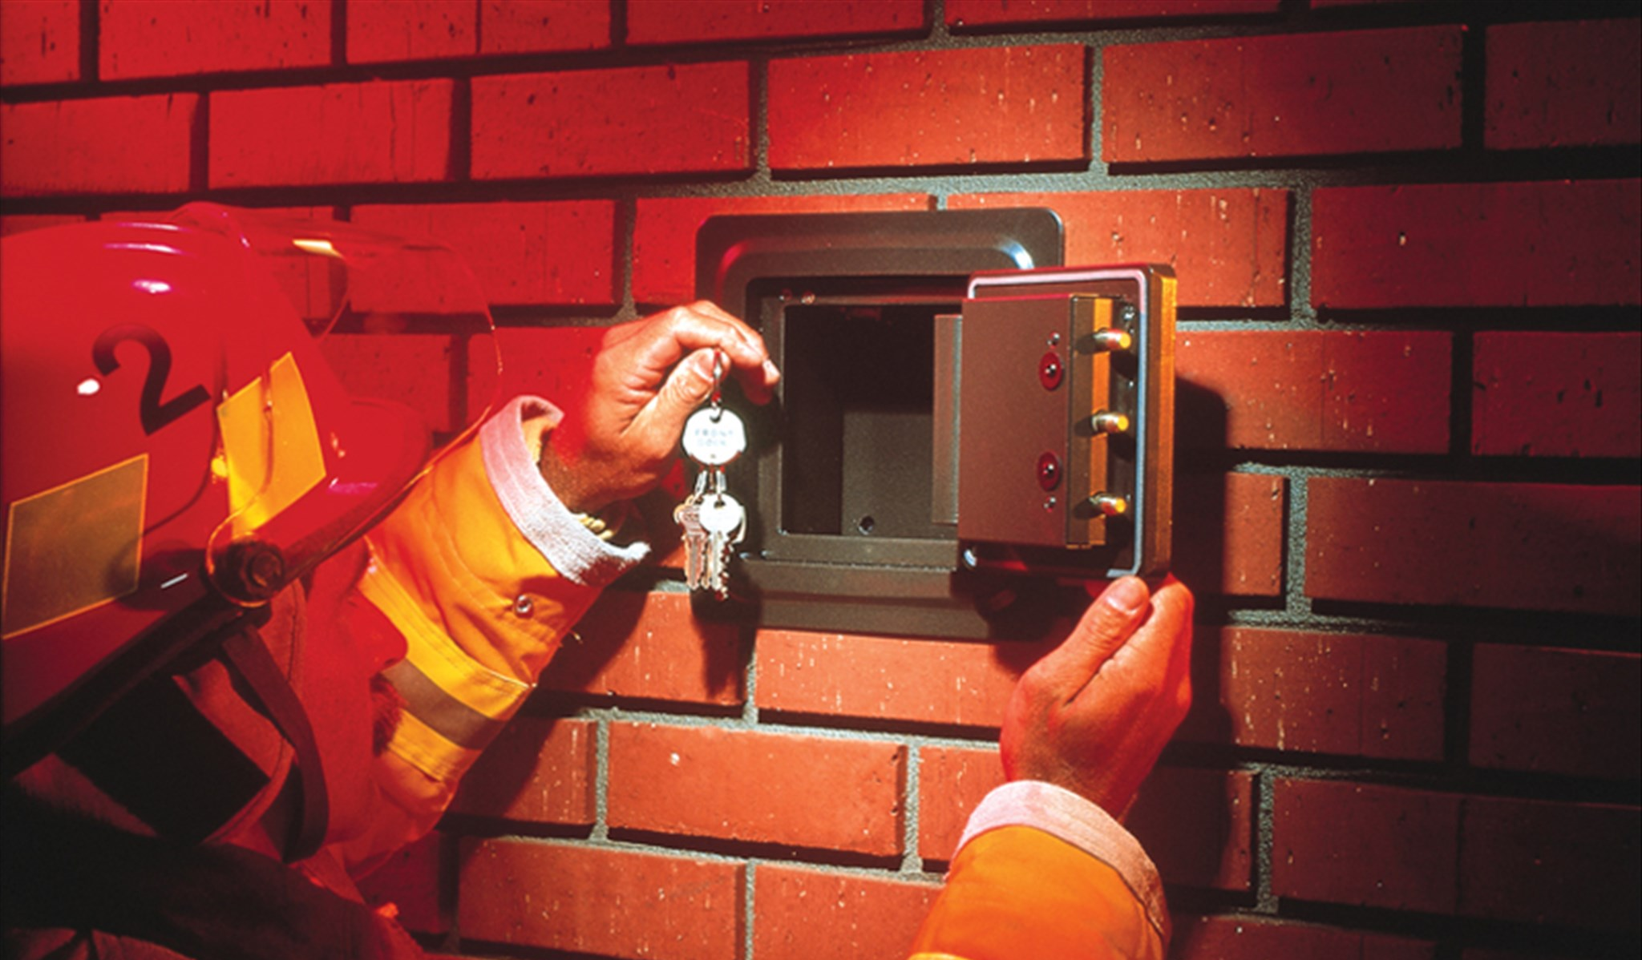
Compliance and Risk Services
Check-in QR code
CERA Implemented a new Policy Management system to streamline processes and improve transparency.
EHS developed a new QR code keychain system to quickly provide building information to emergency responders!

Slide 17
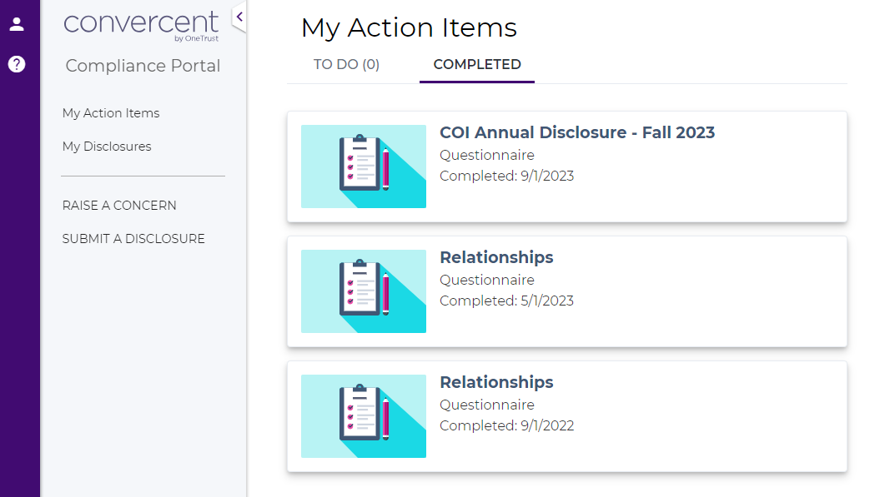
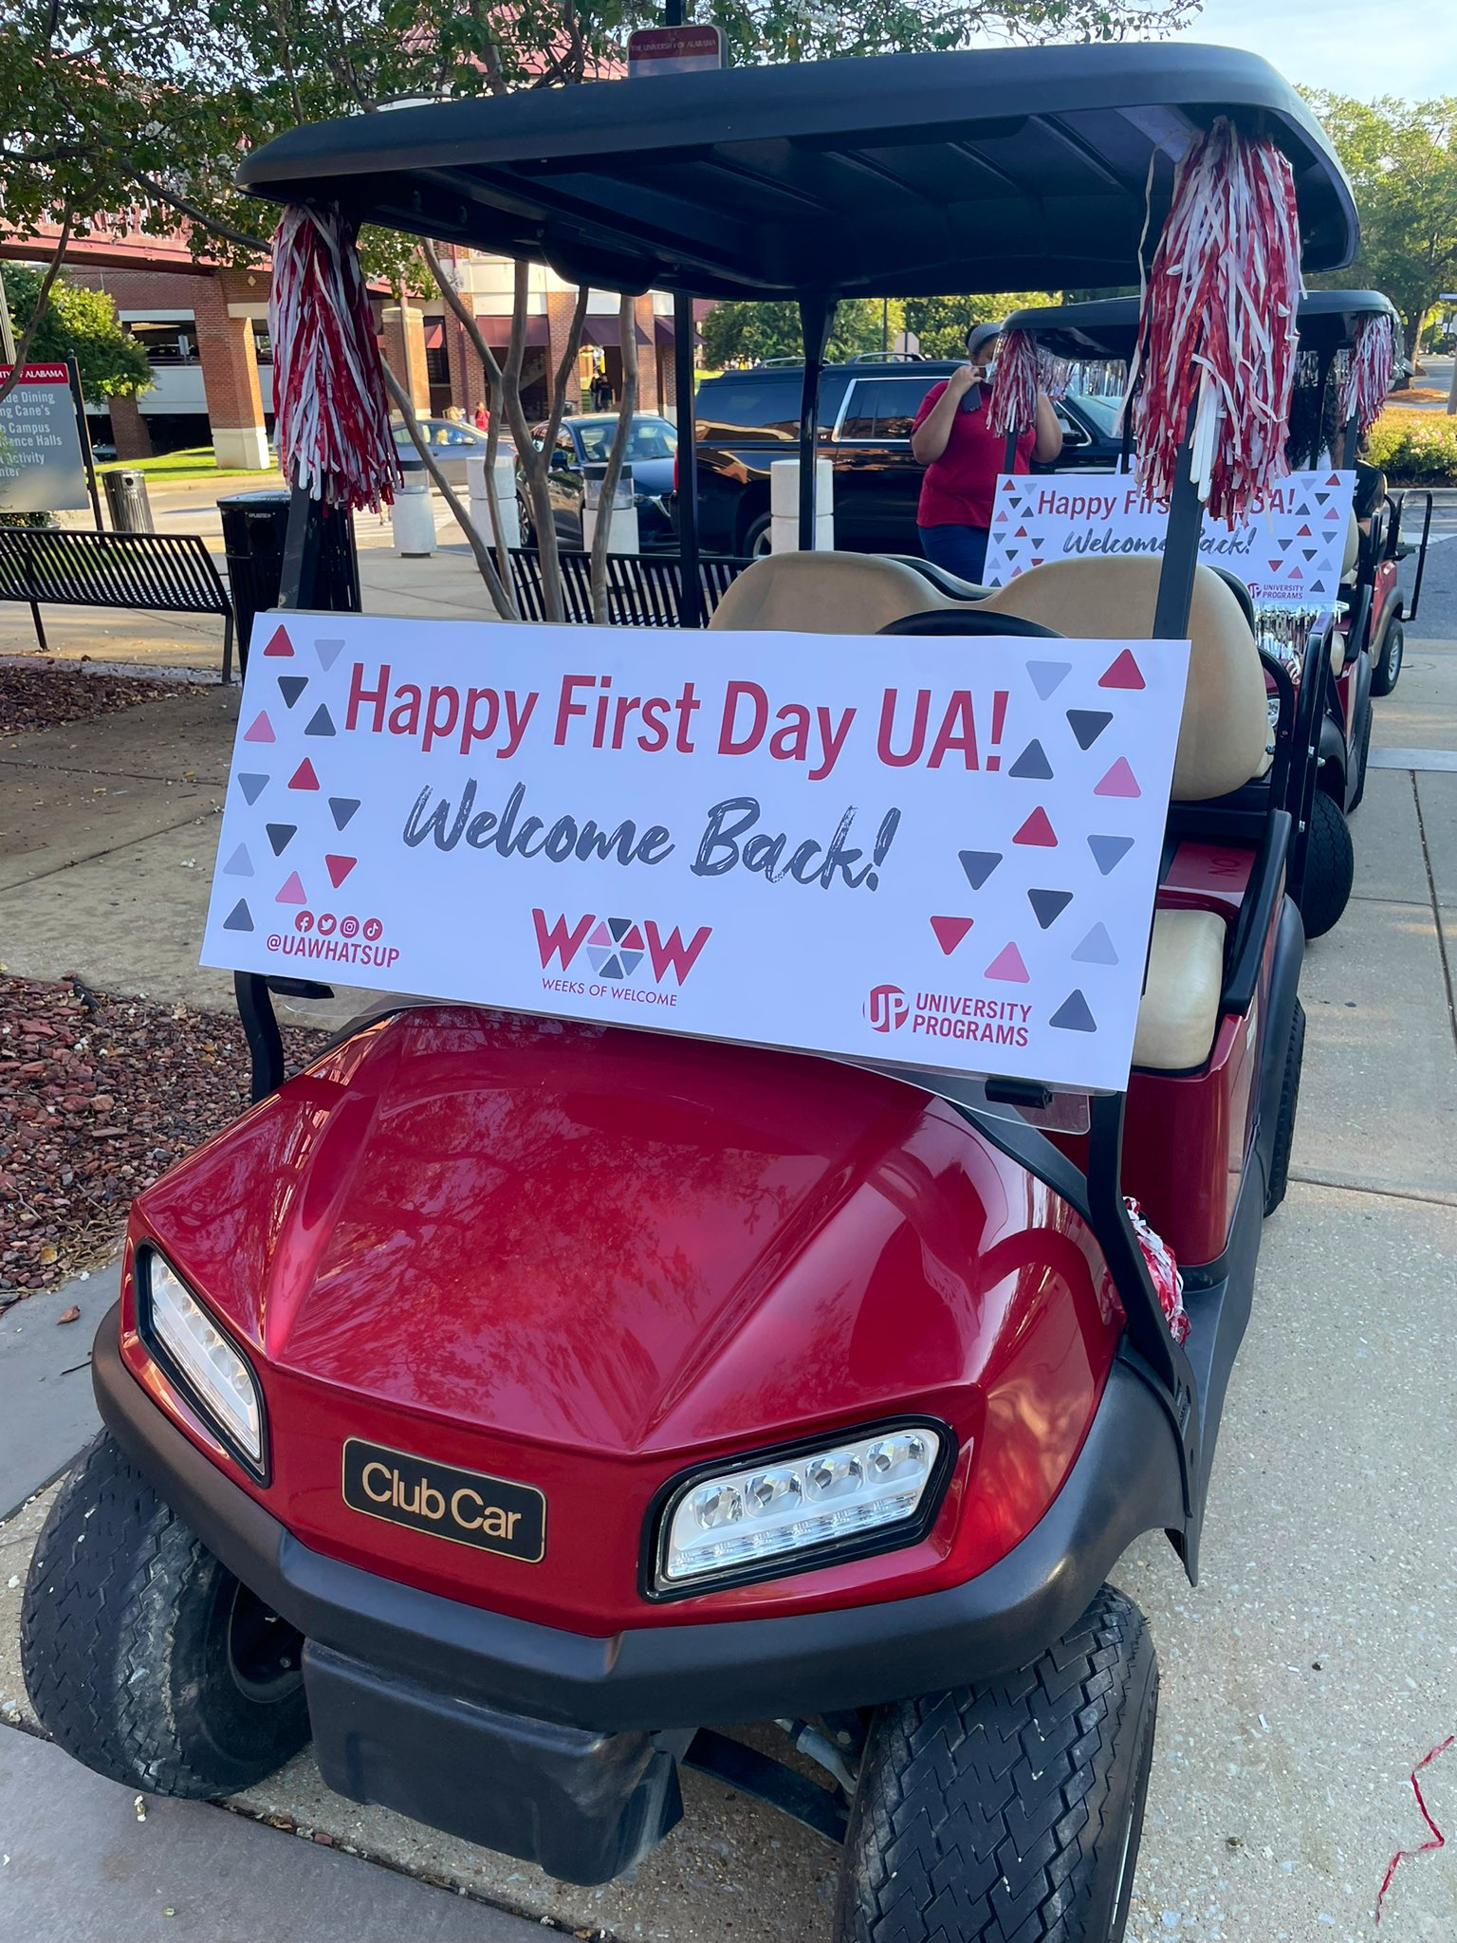
Compliance and Risk Services (page 2)
Check-in QR code
CERA collaborated with other departments to consolidate reporting channels for Conflicts of Interest.
Risk Management updated Utility Cart Safety standards to protect our campus community.

Slide 18
Division of Public Safety
Check-in QR code
Updated and improved automotive security and monitoring resulting in a reduction of loss.
UAPD Continuous improvement Effort: Dedicated teams for onboarding new officers and enhancing the Security Resources Department.
Emergency Operations Planning and preparedness: Consolidated Severe Weather Emergency Action Plan in progress.
Gameday Operations redeveloping and editing the UA campus bird map for gameday public safety, which will show materials, law enforcement posts, contracted security posts, and parking lot attendants.

Slide 19
Finance & Operations Shared Administrative Services
Check-in QR code
Agility Channel in Teams – Collaborative space to interact with department colleagues, share leading practices, encourage friendly dialogue, and promote psychological safety.
Agility Submission Form – Online form to encourage colleagues to submit their process improvement ideas to be reviewed objectively by the Agility Team.
Collaborative Meetings including Lunch n’ Learn Series – Fosters collaboration with other F&O departments by introducing teams
and removing barriers to communication.
Once-A-Month Wednesdays (OMW) Employee Engagement Events – Development and maintenance of psychological safely among team members through interactions in a friendly and familiar environment.

Slide 20
Enterprise Operations
Check-in QR code
Psychological Safety training for all departments within Enterprise Operations.
Change Management class for Enterprise Operations Management.
Encouraging contribution of ideas. Working together on ideas of continuous improvement
University Supply Store – Increased contributions to the University for Scholarships​.
Dining Services – Starbucks on University Blvd.
Printing Services – Online order entry​
Action Card – Online photo submission system
Enterprise Operations – Reverse Vending ​Machines​

Slide 21
Human Resources
Check-in QR code
PageUp to Banner Integration
Performance Review System Update
Classification and Compensation Study and Implementation
Fringe Benefit Rate Implementation
New Employee Start Date and Onboarding Process
UALMS Dashboard Redesign
Voluntary Retirement Plan Enhancements

